Slide 1
INTRODUCTION TO THE CPU
NAME:AURSHIA
SUBJECT :ICT(LAB)

Slide 2
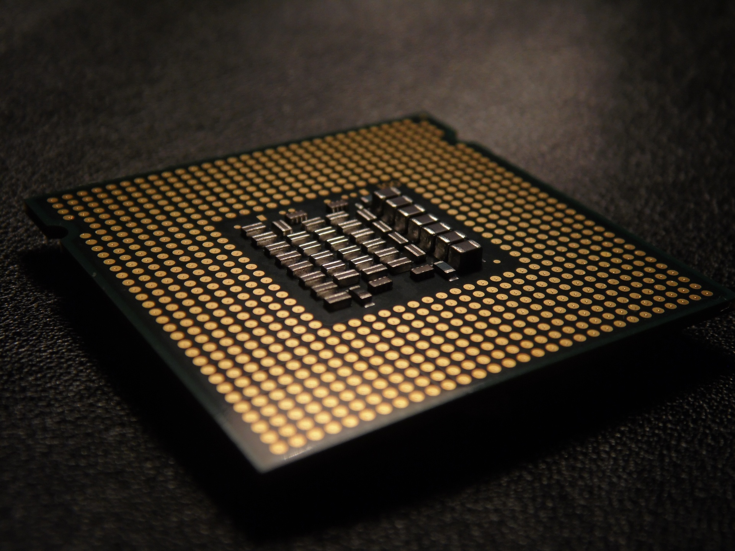
CENTRAL PROCESSING UNIT
THE BRAIN OF THE
COMPUTER

Slide 3
WHAT IS A CPU?
The CPU is the main component of a Computer that processes instructions.
It is often reffered as the BRAIN of the Computer because it performs calculations and executes commands.
Every action you take on a Computer, like opening a file or running a program, is processed by the CPU.

Slide 4
BASIC FUNCTIONS:
FETCH
It retrives Instructions from the memory.
DECODE
It interprets what the Instructions mean.
EXECUTE
It performs the Instructions , such as adding numbers or moving data.

Slide 5
MAIN COMPONENTS:
The CPU consist of two main parts;
CONTROL UNIT(CU):
It directs the flow of data and tells other parts of the Computer how to respond to instructions.
ARITHMETICLOGIC UNIT(ALU):
This is where mathematical calculations and logical operations are carried out.

Slide 6
CLOCK SPEED:
Clock Speed is how fast a CPU can process instructions , measured in Gigahertz(GHz).
The higher the clock speed , the more instructions the CPU can process pre second.
EXAMPLE:
A 3GHz CPU can perform 3 billion cycles per second.

Slide 7
MULTICORE CPUs:
Modern CPUs often have multiple cores, such as dual-core or quad-core.
Each core can process its own set of instructions independently.
More core allow the CPU to handle more tasks simultaneously, improving performance for complex applications.

Slide 8
CPU INTERACTION WITH OTHER COMPONENTS
The CPU works in coordination with other components:
RAM(RANDOM ACCESS MEMORY):
Temporarily stores data that the CPU needs quick to access to.
HARD DRIVE:
Stores data long-term that the CPU can retrieve when needed.
INPUT/OUTPUT DEVICES:
The CPU processes input from devices like keyboard or mouse and sends output to devices like screens or printer.

Slide 9
IMPORTANCE:
Without the CPU , the Computer cannot function , no instructions could be processed.
It determines how fast your Computer can perform tasks likerunning software , browsing the internet , or playing games.

Slide 10
SUMMARY:
The CPU is the core of every Computer system.
It performs all processing tasks through the fetch , decode and execute cycle.
Key factor in CPU performance include clock speed , the number of cores , and its ability to communicate with other Computer components.

